Slide 1

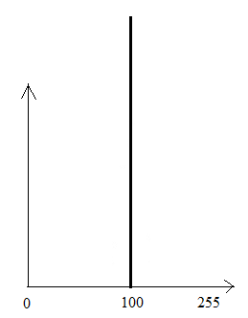

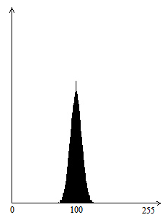

Homework 6 (Due: 5/1 )
(1) Create an image g(x,y) whose pixels all have the same gray
value of 100. Show the image g(x,y).
(2) Generate Gaussian noise n(x,y), with , using
the algorithm shown in the next page.
Show the noisy image f(x,y) = g(x,y) + n(x,y).
(3) Display the histogram h(i) of f(x,y).
(4) Comment on your results.
Example:
Input image g(x,y) of gray values of 100
Histogram
of g(x,y)
Noisy image
f(x,y)
Histogram
of f(x,y)

Slide 2
